Slide 1
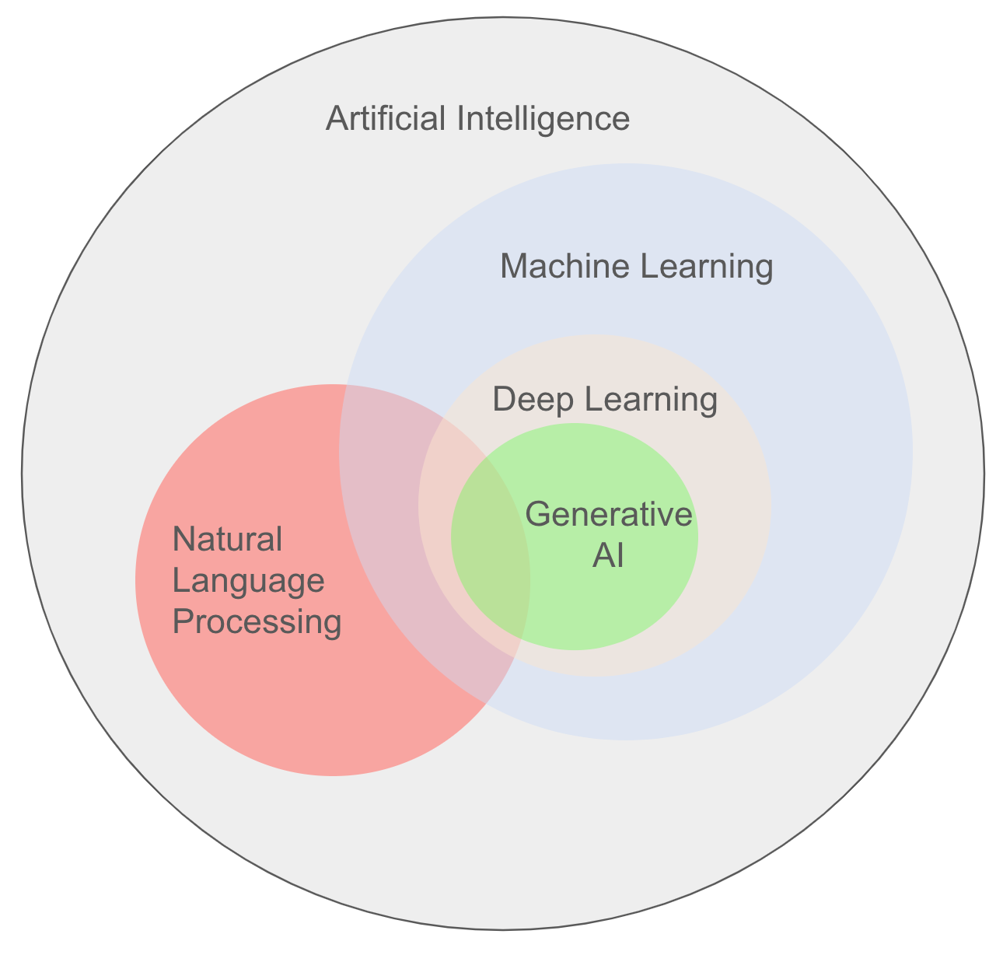
CHAP 1 : UNDERSTANDING AI & GENERATIVE AI

Slide 2
Agenda
• Artificial Intelligence Fundamentals
• Evolution of AI Technologies
• Traditional AI vs Generative AI
• How Generative AI Works
• Types of Generative AI Models
• Enterprise Applications & Use Cases
• Business Impact and Opportunities
• Chapter Review & Discussion

Slide 3
Why are we learning AI?
✔ AI is changing the software industry.
✔ Every software role is using AI.
✔ AI helps us work faster and smarter.
✔ AI is a productivity tool, not a replacement.
✔ Learning AI is becoming an important professional skill.
Oracle JET
(Build)
↓
DevOps
(Deploy)
↓
AI
(Work Smarter)
Developer + AI = Better Productivity

Slide 4
AI Around Us
📺 Netflix → Movie Recommendations
📧 Gmail → Spam Detection
🗺 Google Maps → Best Route
🛒 Amazon → Product Recommendations
💳 Banking Apps → Fraud Detection
📱 Instagram → Content Suggestions
💬 ChatGPT → Content Generation
Netflix
Instagram Google Maps
👤 You
Banking Gmail
ChatGPT

Slide 5
What is Artificial Intelligence?
Artificial Intelligence is the ability of a computer system to perform tasks that normally require human intelligence.
Examples:
Learning
Reasoning
Problem Solving
Decision Making
Understanding Language
At the bottom:
AI does not think like humans. It learns patterns from data.

Slide 6
The History of AI
1950s - Rule-Based Systems: Explicitly programmed "If/Then" logic paths. If a condition wasn't explicitly coded, the system failed.
2000s - Machine Learning: Algorithms learn patterns directly from data without being explicitly hardcoded ($Y = f(X)$).
2010s - Deep Learning: Multi-layered artificial neural networks processing unlabelled complex data (images, voice).
2020s - Generative AI: Emergence of parallel-processed Transformer architectures capable of scaling to human-like text creation.

Slide 7
The 3 Horizons of AI Capacity
Artificial Narrow Intelligence (ANI)
Designed for one specific task
Example: ChatGPT, Google Maps, Siri
Artificial General Intelligence (AGI)
Can perform any intellectual task like a human
Still under research
Artificial Super Intelligence (ASI)
More intelligent than humans
A future concept
At the bottom, highlight:
Today, almost all AI applications belong to ANI.

Slide 8
Traditional AI vs. Generative AI
Traditional AI | Generative AI
Predicts | Creates
Classifies data | Generates content
Uses existing information | Produces new information
Spam Detection | ChatGPT
Fraud Detection | GitHub Copilot
Recommendation Systems | Image Generation
Input Data
Prediction
Output
Prompt
AI Model
New Content (Text, Code, Image)

Slide 9
What is Generative AI?
Generative AI is a type of Artificial Intelligence that creates new content based on the instructions given by the user.
It can generate:
Text
Code
Images
Audio
Videos
Presentations
Generative AI creates. It does not simply search or copy information.

Slide 10
The Five Modalities of Content Generation
The Generative Toolkit:
Text: Long-form summaries, reports, technical specifications, emails.
Code: Functional programming blocks, database queries, infrastructure scripts.
Images: Synthetic user interfaces, architectural mockups, visual assets.
Audio: Synthetic voiceovers, voice command recognition, text-to-speech.
Video: Dynamic simulation environments, automated walkthrough captures.

Slide 11
Understanding AI, LLM and ChatGPT and Where Does ChatGPT Fit?
Generative AI | Large Language Model (LLM) | ChatGPT
The technology | The AI model | The application you use
Generative AI
Creates new content like text, code, images and summaries.
LLM
A type of Generative AI that understands and generates human language.
ChatGPT
A chat application that allows users to interact with an LLM.
At the bottom of the slide, highlight this sentence:
ChatGPT is an application powered by an LLM. An LLM is one type of Generative AI.

Slide 12
How Generative AI Works (High-Level Framework)
User Prompt
LLM Reads the Prompt
Finds Patterns Learned During Training
Generates the Best Possible Response
User Reviews and Uses the Output
Training: Learning from massive datasets.
Patterns: Identifying structures, grammar, and pixel relationships.
Prediction: Anticipating the most logical next word or element.
Generation: Creating entirely brand-new content.
AI generates responses based on patterns learned from data. It does not "think" like a human.

Slide 13
Enterprise Applications of Generative AI
💻 Software Development | 📞 Customer Support | 📄 Documentation
Generate code, debug, review | AI Chatbots | Reports, manuals, emails
📊 Data Analysis | 🎯 Business Productivity | 📚 Learning & Training
Summarize data, insights | Meeting notes, presentations | Explain concepts, create quizzes
Generative AI helps people work faster, improve quality, and save time.

Slide 14
Knowledge Check
Question 1: When Spotify generates your automated "Discover Weekly" playlist, is it using Predictive AI or Generative AI?
Question 2: If you ask an assistant to read an internal corporate wiki and draft a 500-word software onboarding manual, which paradigm is active?

Slide 15
Popular Generative AI Models
Company | AI Model | Known For
OpenAI | GPT | General-purpose AI, coding, writing, reasoning
Google | Gemini | Search integration, multimodal capabilities
Anthropic | Claude | Long documents, coding, analysis
Meta | Llama | Open-source AI models
Oracle | OCI Generative AI | Enterprise AI for Oracle Cloud
Different AI models have different strengths. The best model depends on the business requirement.

Slide 16
Oracle's AI Vision
Oracle focuses on bringing AI directly into business applications.
OCI Generative AI
Access enterprise-ready AI models through Oracle Cloud.
AI in Oracle Fusion Applications
Built-in AI features in HCM, ERP and SCM.
Enterprise Security
Designed with privacy, security and business data protection.
Developer Productivity
AI services for application development and automation.
Oracle's goal is to make AI secure, reliable and useful for enterprise customers.

Slide 17
AI in Software Development
Phase | How AI Helps
Requirements | Summarize business requirements
Design | Suggest UI layouts and workflows
Development | Generate code and explain existing code
Testing | Create test cases and test data
Debugging | Explain errors and suggest fixes
Documentation | Generate user guides and technical documents
AI assists developers throughout the SDLC—it does not replace software engineering knowledge.

Slide 18
Benefits of Generative AI
Benefit | Example
Faster Work | Generate reports, emails and code in seconds
Higher Productivity | Reduce repetitive manual tasks
Better Creativity | Brainstorm ideas and create multiple solutions
Improved Quality | Review content and suggest improvements
Better Decision Support | Summarize large documents and extract insights
AI helps people work smarter and faster, but human review is still important.

Slide 19
Real Enterprise Success Stories
JPMorgan Chase
AI reviews commercial loan documents.
Saves thousands of hours of manual work.
Walmart
AI optimizes delivery routes and inventory planning.
Improves efficiency and reduces transportation costs.
BMW
AI-powered computer vision checks vehicle quality during manufacturing.
Helps detect defects earlier.
Organizations use AI to improve efficiency, accuracy and decision-making.

Slide 20
Chapter Summary
Artificial Intelligence enables machines to assist humans in solving problems and performing tasks.
Generative AI creates new content such as text, code, images, audio, and videos using Large Language Models (LLMs).
Organizations are adopting AI across business functions to improve productivity, automation, and decision-making.
AI supports software developers throughout the SDLC by assisting with coding, testing, debugging, and documentation.
Effective use of AI depends on understanding its capabilities and communicating with it through clear prompts.

Slide 21
Quiz
What is the primary purpose of Generative AI?
A. To store data securely
B. To create new content such as text, code, and images
C. To replace databases
D. To improve internet speed
Notes:
Answer: B. To create new content such as text, code, and images

Slide 22
Quiz
2. Which of the following is an example of a Large Language Model (LLM)?
A. Oracle Database
B. GPT
C. Microsoft Excel
D. Git
Notes:
Answer: B. GPT

Slide 23
Quiz
3. Which business function commonly uses AI for resume screening and candidate matching?
A. Finance
B. Human Resources (HR)
C. Supply Chain
D. Marketing
Notes:
Answer: B. Human Resources (HR)

Slide 24
Quiz
4. How can AI assist software developers?
A. By replacing all developers
B. By writing code, explaining errors, generating tests, and creating documentation
C. By designing computer hardware
D. By increasing internet bandwidth
Notes:
Answer: B. By writing code, explaining errors, generating tests, and creating documentation

Slide 25
Quiz
5. What is one of the main benefits of Generative AI for organizations?
A. It eliminates the need for human review.
B. It automatically makes every decision correctly.
C. It improves productivity by reducing repetitive work.
D. It guarantees 100% accurate responses.
Notes:
Answer: C. It improves productivity by reducing repetitive work.

